Slide 1
Skinrender
Tom Kedik, Alaric Sheer Hardwick

Slide 2
Current Build

Slide 3
Summary
Game world creation begun
Intro events in place
First animation added
Depth sorting reworked
Dynamic viewcones
Dialogue and thematic elements have begun to be added
Game world layout planned

Slide 4
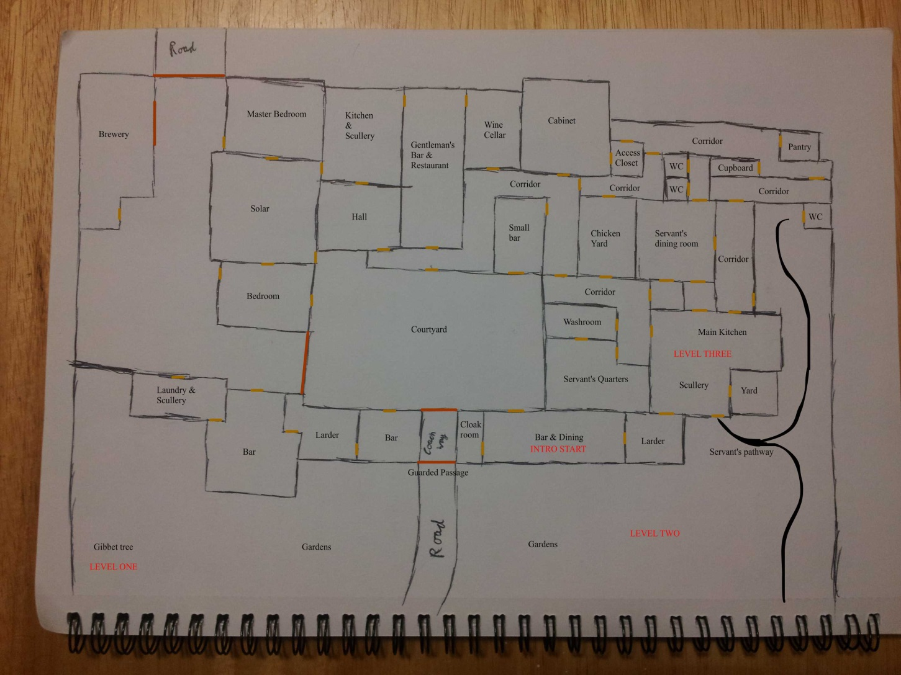
Game World

Slide 5
Milestones
Before Christmas: Core art assets, disguise mechanic, puzzle playtests & iteration. [Complete]
After Christmas: Puzzle designs focusing on recently implemented mechanics, further essential art assets. [Complete]
Before Easter: Core code refined, important animations implemented, audio added, and good amount of game constructed [In progress]
After Easter & beyond: Refinement of existing elements and implementation of final game puzzles

Slide 6
Immediate Future
Further animations
Additional exterior props
Playtests of intro areas and UX elements
Fix dynamic viewcone collision bug
Polish second part of intro
Implement previously designed puzzles

Slide 7
Project Management
E-mail communications returned to normal
Team is aware at all times of task progress due to regular meetings
Hours Logged
Tom Kedik – 115.8h
Alaric – 111.5h
Total – 227.3h

Slide 8
Questions
What would you like to know about Skinrender?

